Slide 1


Slide 2

Proud
to be
Indian

Slide 3


Slide 4

What is an e-waste ?
E-waste are those electronic equipments/ products that connect with power plug, batteries which have become obsolete due to :
- Advancement in technology .
Change in fashion, style and status.
Nearing the end of there useful life .

Slide 5
Types of e-wastes
Mobile Phones | Washing Machine
Computers | Cartridges
Servers | Military Electronic
Telecom | Mother board
TV | Alarm
Calculators | Sirens
Audio | Automobile catalytic converters
Scanners | Sensor
Printers | CD
Air Conditioner | Security Device
Microwave

Slide 6
Why E-waste Hazardous?
Rapid
Technology
Changes
Increased
Consumer
Electronic
Purchases
More
E-Waste
More
Hazardous
Materials
Landfilled
Increasing
Human
Health Risks

Slide 7
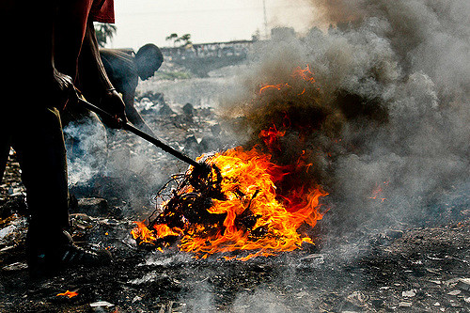
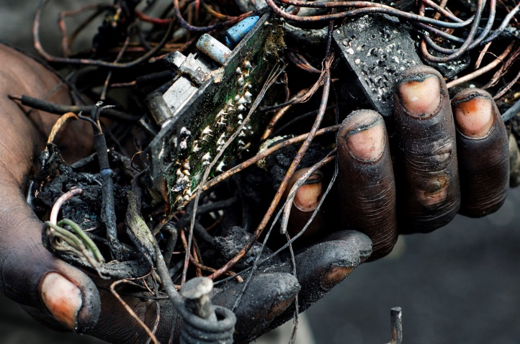
Burning of E-waste produces 500 times pollution than other means

Slide 8
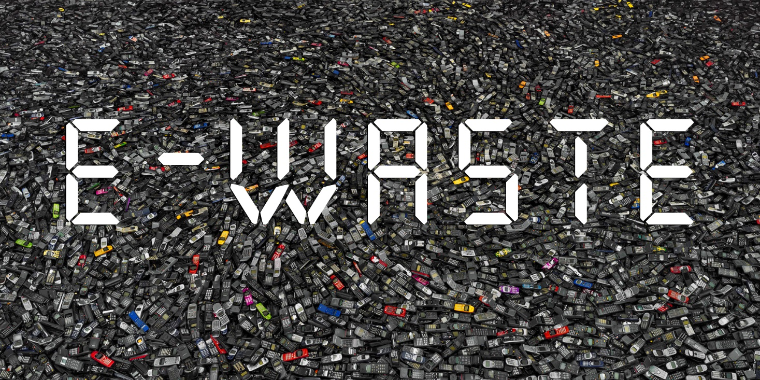
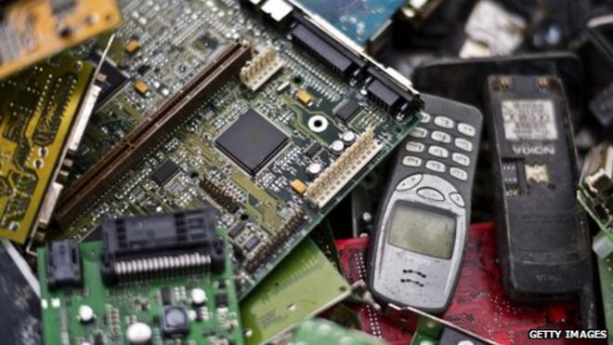
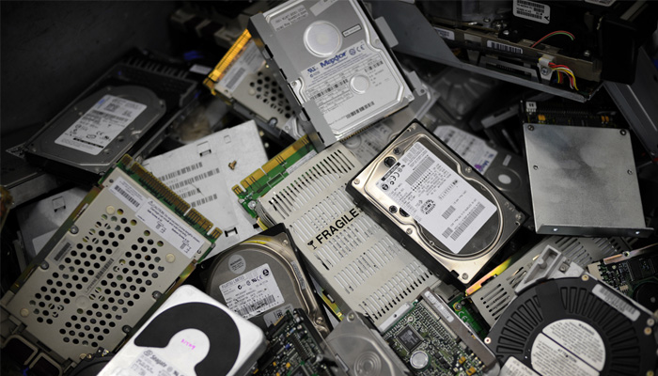

Slide 9


Slide 10
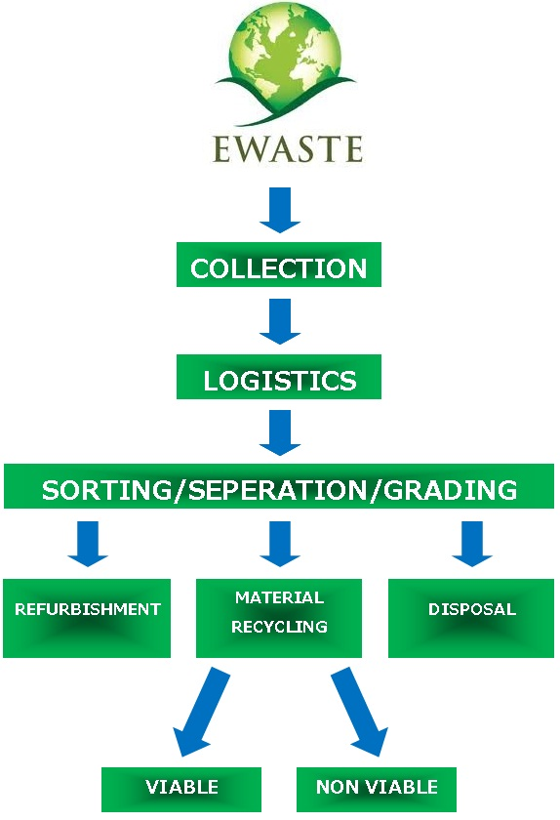

Slide 11
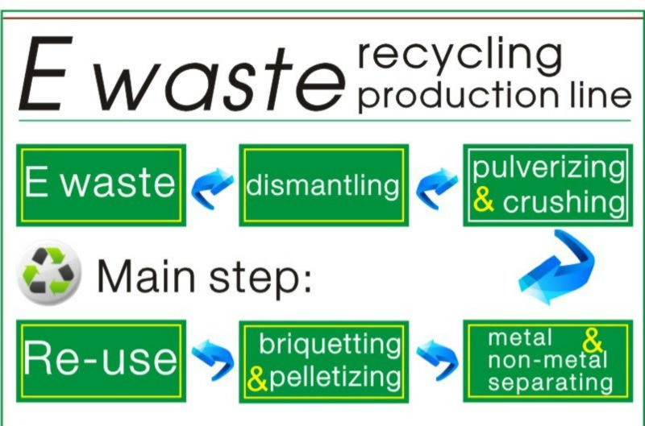

Slide 12


Slide 14

presentation by
Harikrishna aj
harigovindan mg
Arjun nm
joel john
We hope you enjoyed our Presentation.
Thank you

